Slide 1
Beagle Bone activity with Ultrasonic Sensor (IoT)
Notes:
NOTES ABOUT THIS TEMPLATE
A design theme has been created for ease of use and consistency. Within the theme the background, font choice, and colors have been preset.
FONT: the font is set to Arial. Keep within this font family to ensure consistency within document and when opening on various computers.
COLORS: only use UNO designated colors which have been made into swatches and can be found under ”theme colors”
COPY: use textboxes to add copy to each new slide
LAST SLIDE: the last slide features the Lock-up and a combination of the Non-discrimination and accessibility statements. Please keep this at the end of your presentation in order to meet university brand policies.

Slide 2
Agenda of the Presentation:
Circuit Diagram and Beagle Bone Configuration
Driver Signature Enforcement in Windows 10
Installation of the Beagle bone Device Drivers
Taking object distance measurements using Beagle bone and Ultrasonic Sensor

Slide 3
CIRCUIT DIAGRAM & BEAGLE BONE CONFIGURATION

Slide 4
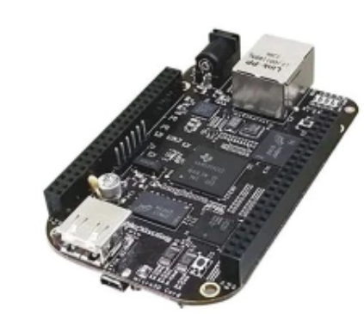
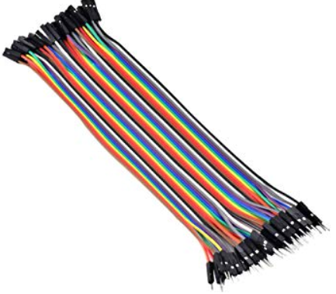
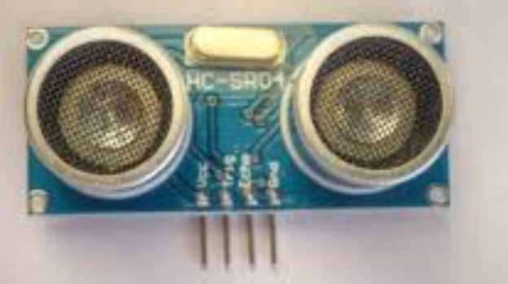
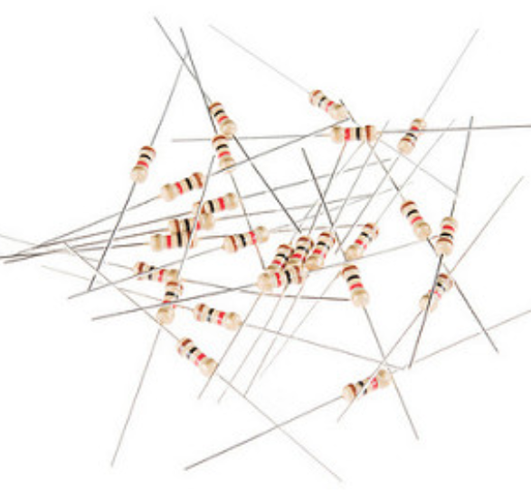
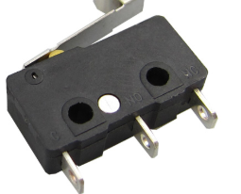
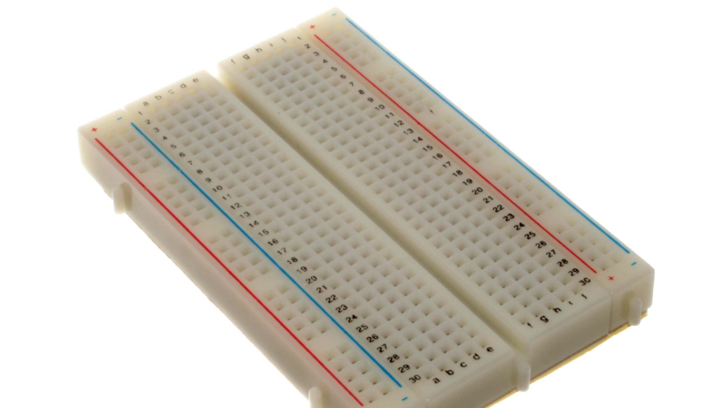
CONNECTING ELECTRICAL COMPONENTS
Beagle bone
Connecting Wires
Ultrasonic Sensor
Resistors 1K
Switch
Breadboard

Slide 5
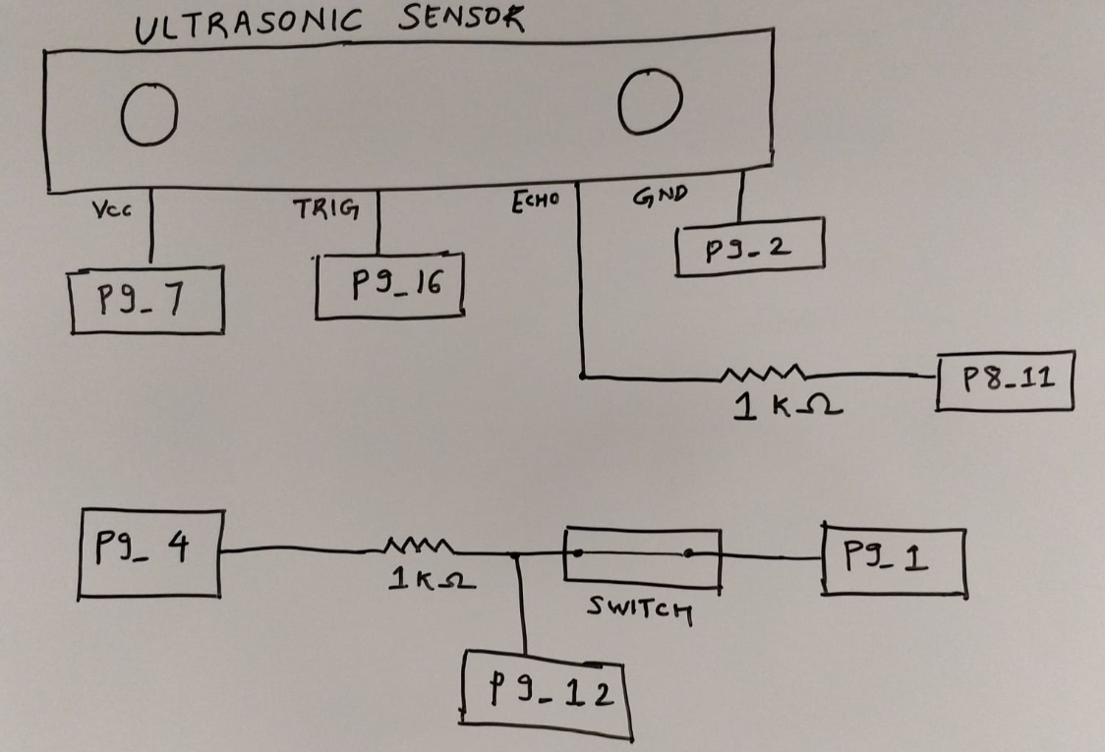
CIRCUIT DIAGRAM

Slide 6
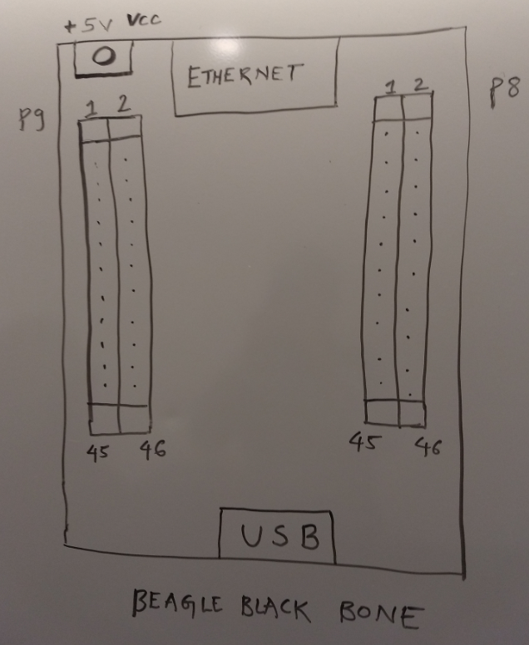
BEAGLEBONE CONFIGURATION

Slide 7
DRIVER SIGNATURE ENFORCEMENT WINDOWS 10

Slide 8

INSTALLING DRIVERS ON WINDOWS 10 SYSTEMS
Windows 10 systems require the “Driver Signature Enforcement”, which means they only allow drivers which are verified by Microsoft.
https://windowsreport.com/driver-signature-enforcement-windows-10/

Slide 9
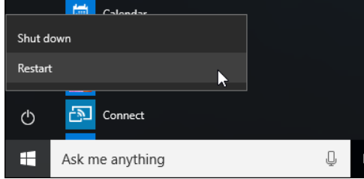
DISABLE DRIVER SIGNATURE ENFORCEMENT
STEP-1:
Restart the system by holding down the Shift Key.

Slide 10
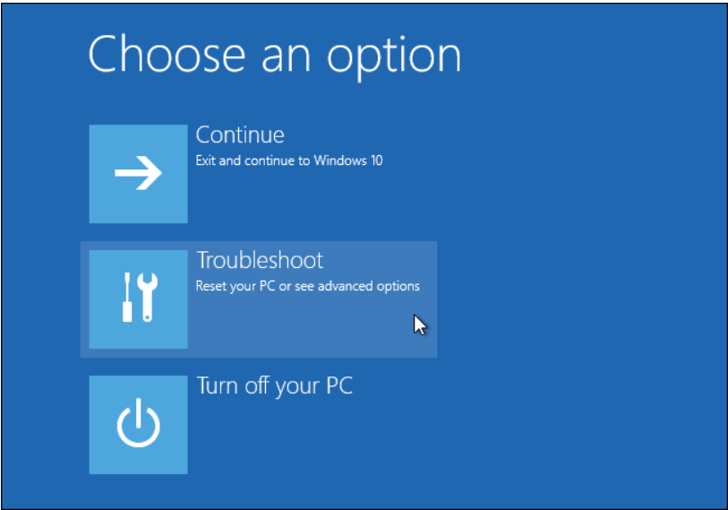
TO DISABLE DRIVER SIGNATURE ENFORCEMENT
STEP-2:
From the Choose an option screen, select the “Troubleshoot” option.

Slide 11
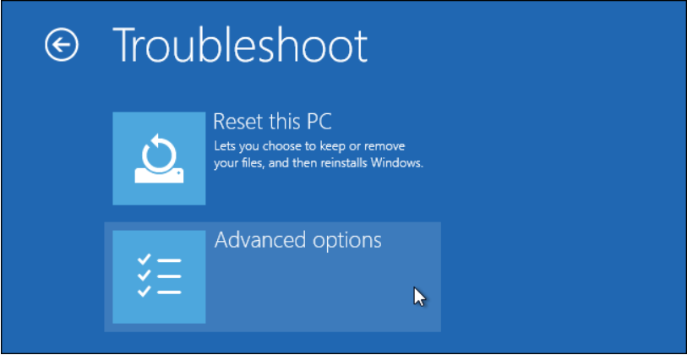
TO DISABLE DRIVER SIGNATURE ENFORCEMENT
STEP-3:
Select the “Advanced Options” from the Troubleshoot screen.

Slide 12
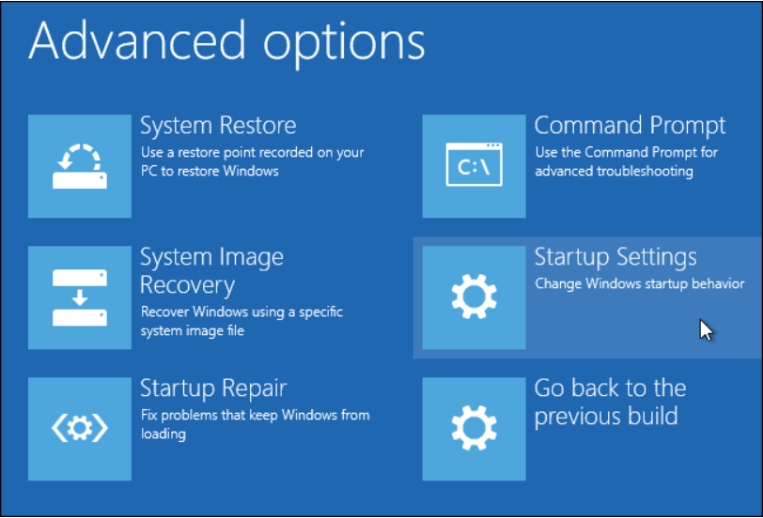
TO DISABLE DRIVER SIGNATURE ENFORCEMENT
STEP-4:
Select Startup Settings from the Advanced Options page.

Slide 13
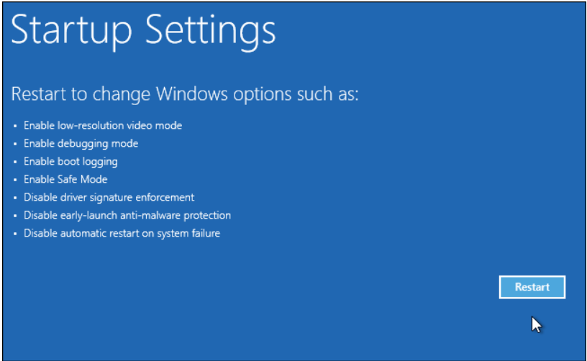
TO DISABLE DRIVER SIGNATURE ENFORCEMENT
STEP-5:
Click on the Restart button from the Startup Settings Page

Slide 14
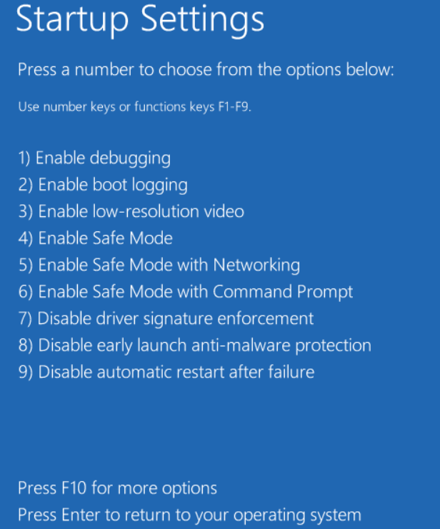
TO DISABLE DRIVER SIGNATURE ENFORCEMENT
STEP-6:
Press 7 or F7 to disable driver signature enforcement.

Slide 15
TO DISABLE DRIVER SIGNATURE ENFORCEMENT
The system will now restart with the driver signature enforcement disabled.
And the Beaglebone drivers can be installed on the Windows 10 system.

Slide 16
INSTALLING BEAGLE BONE DRIVERS

Slide 17
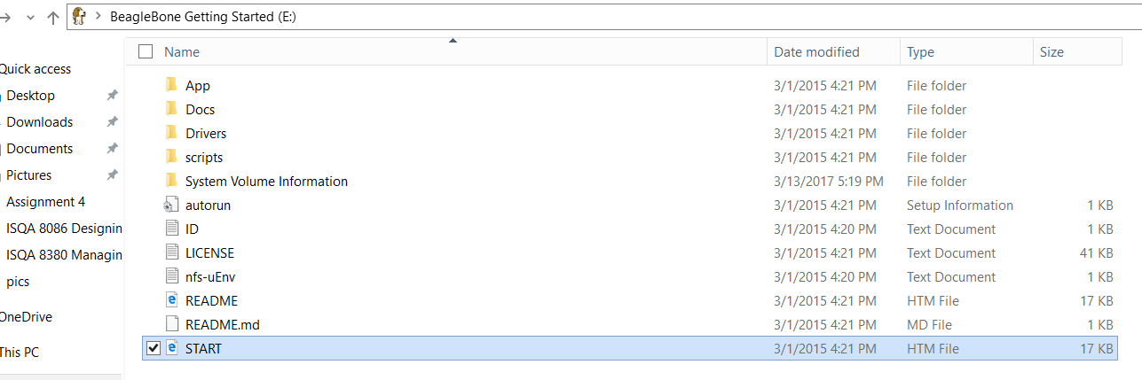
INSTALL BEAGLEBONE DRIVERS
Power on the Beaglebone by connecting it to the USB Adaptor, then we have to install the drivers for establishing communication between Beaglebone and the system.

Slide 18
STEPS TO INSTALL BEAGLEBONE DRIVERS
Installing Drivers is a one time process.
STEP-1:
First Power on the Beaglebone with all the components connected as per the circuit diagram.

Slide 19
STEPS TO INSTALL BEAGLEBONE DRIVERS
STEP-2:
The files containing the beaglebone drivers opens up, click on the Start html file to get information regarding the drivers.

Slide 20
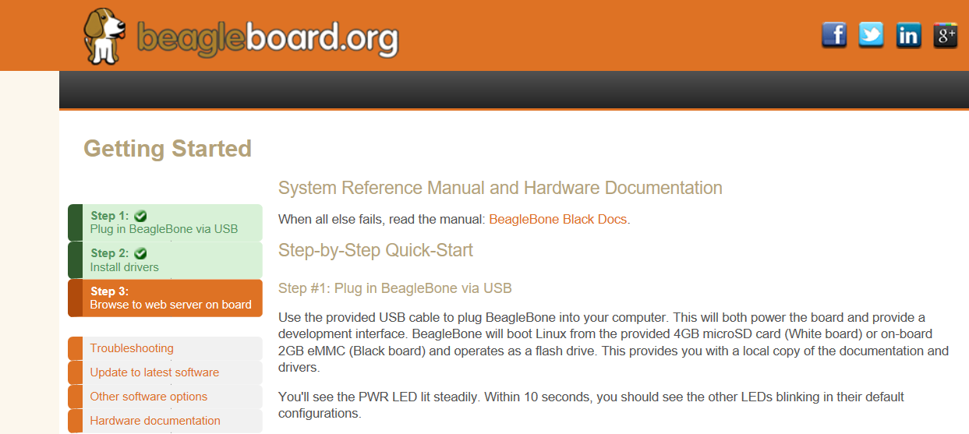
STEPS TO INSTALL BEAGLEBONE DRIVERS
STEP-3:
After clicking the Start html page, go to the Install drivers section.

Slide 21
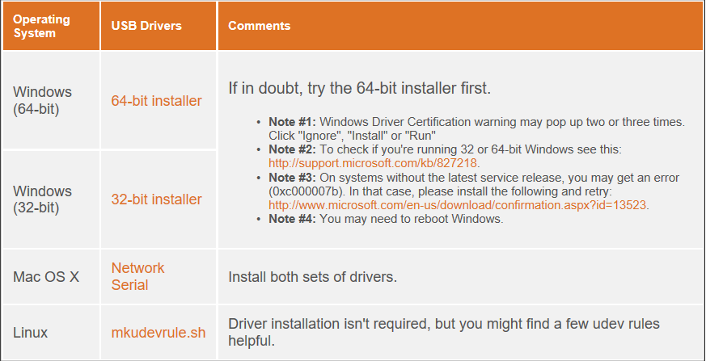
STEPS TO INSTALL BEAGLEBONE DRIVERS
After selecting the Install Drivers section, select the appropriate driver as per your system configuration.

Slide 22
STEPS TO INSTALL BEAGLEBONE DRIVERS
Installation starts and proceed as per the steps in the Installation Process.

Slide 23
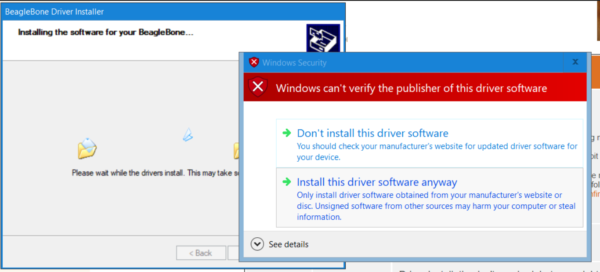
STEPS TO INSTALL BEAGLEBONE DRIVERS
If you are a Windows 10 users you will come across this message, Select Install this driver software anyway

Slide 24
STEPS TO INSTALL BEAGLEBONE DRIVERS
Once it is successfully installed, you are ready to use your Beaglebone Device to communicate with your system!

Slide 25
FLASHING THE CODE ON BEAGLE BONE BLACK

Slide 26
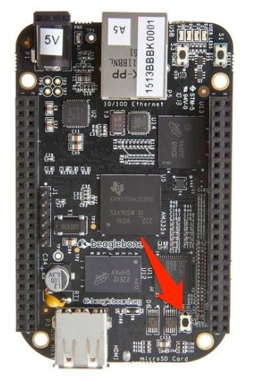
Steps to flash the code on Beaglebone:
Make sure that the Beagle bone is powered on.
Ensure that the MicroSD card in inserted in the Beaglebone slot.
Find the Beaglebone black “User Boot” button, it is located in the same place as the Beaglebone black.

Slide 27
Steps to flash the code on Beaglebone:
Make sure that the Beagle bone is powered on.
Ensure that the MicroSD card in inserted in the Beaglebone microSD card slot.
Find the Beaglebone black “User Boot” button, it is located in the same place as the Beaglebone black.

Slide 28
Steps to flash the code on Beaglebone:
Hold the user boot button and then plug in the power.
Hold the button until the four LED lights power on.
Hold the LED button until you see the LED’s powered on, then release the button.
It will take approximately around 30 to 45 minutes to flash the image on the chip

Slide 29
MEASURING THE OBJECT DISTANCE USING BEAGLEBONE AND ULTRASONIC SENSOR

Slide 30
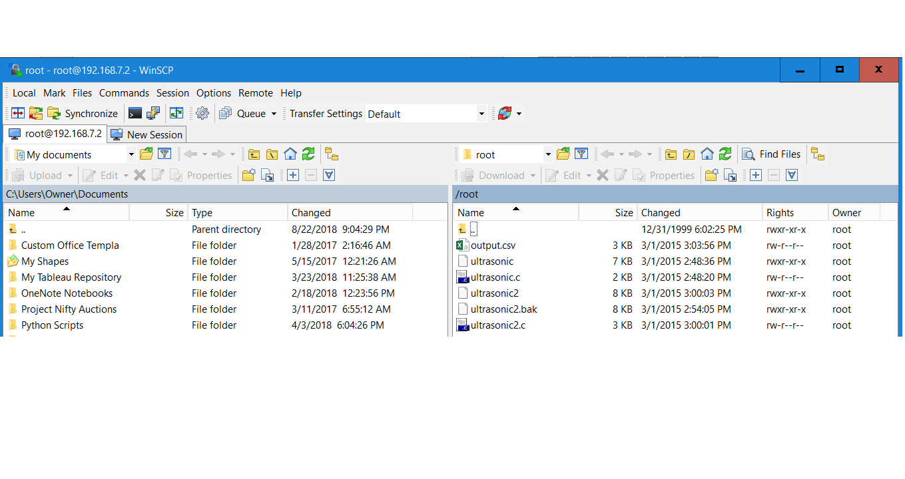
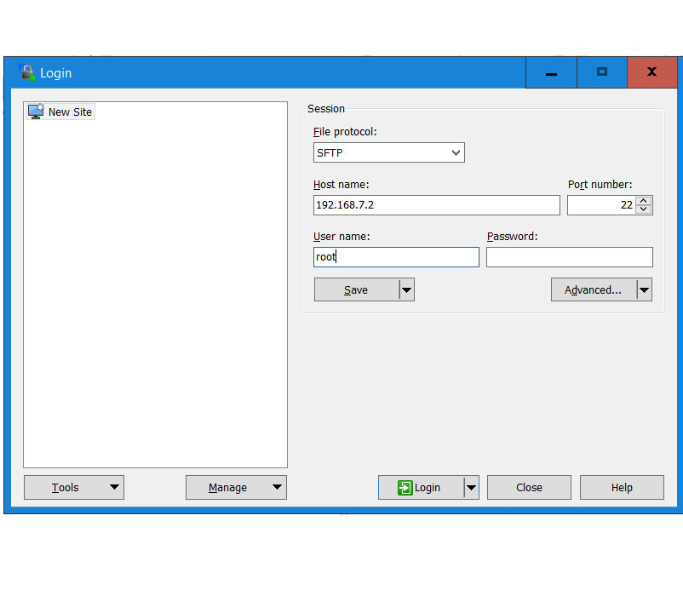
COMMUNICATION WITH THE SYSTEM
After you have connected the circuit, and connected the circuit with the system, you can see the files present in the beaglebone.

Slide 31
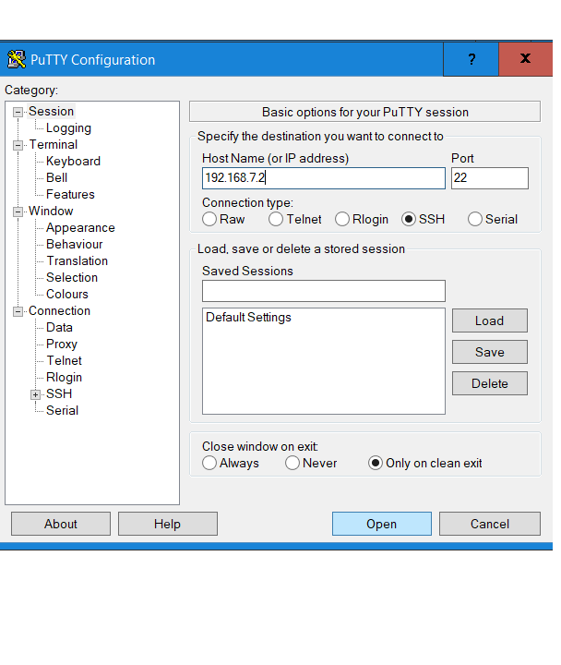
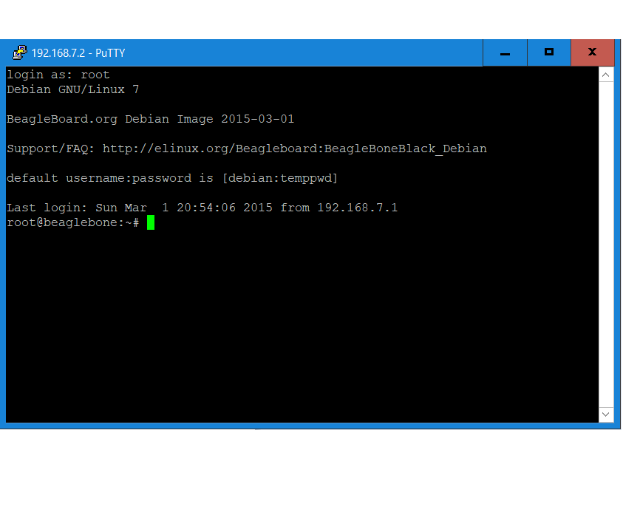
CALCULATE THE DISTANCE USING ULTRASONIC SENSOR
Open the IDE of your choice preferably PuTTy to run the Ultrasonic file.

Slide 32
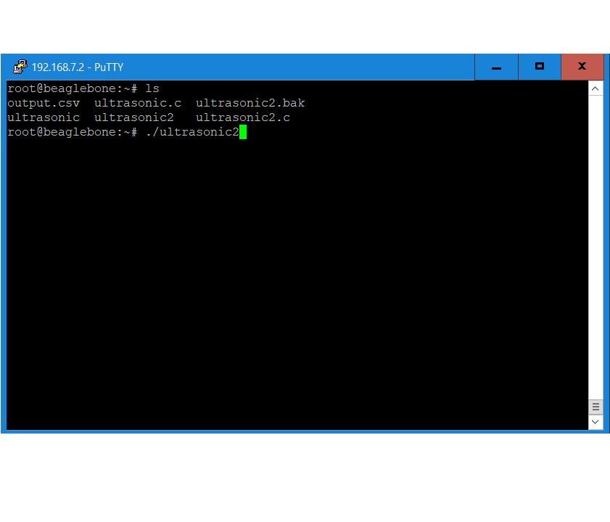
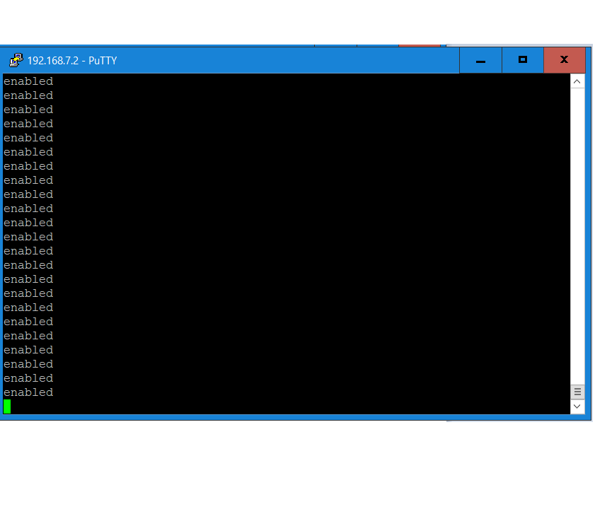
RUN THE ULTRASONIC FILE

Slide 33
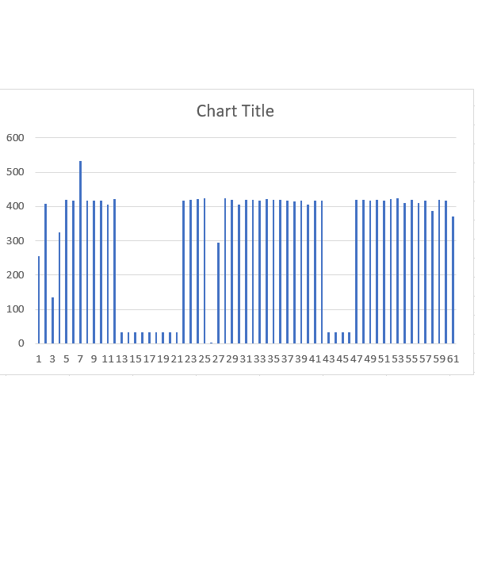
PLOT THE CHART OF THE OUTPUT FROM SENSOR

Slide 34
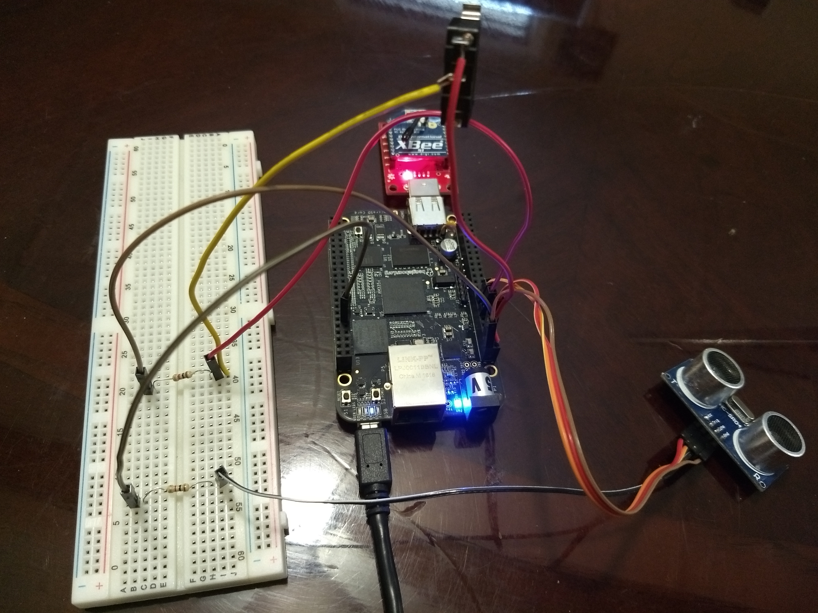
CIRCUIT CONNECTION

Slide 35
BEAGLEBONE AND ULTRASONIC ACTIVITY WITHOUT XBEE

Slide 36
Agenda of the Presentation:
Connect the components as per the circuit diagram
Perform the activity without the XBEE connected to the Beagle bone circuit.
Take the measurements from the ultrasonic sensor as done previously.

Slide 37
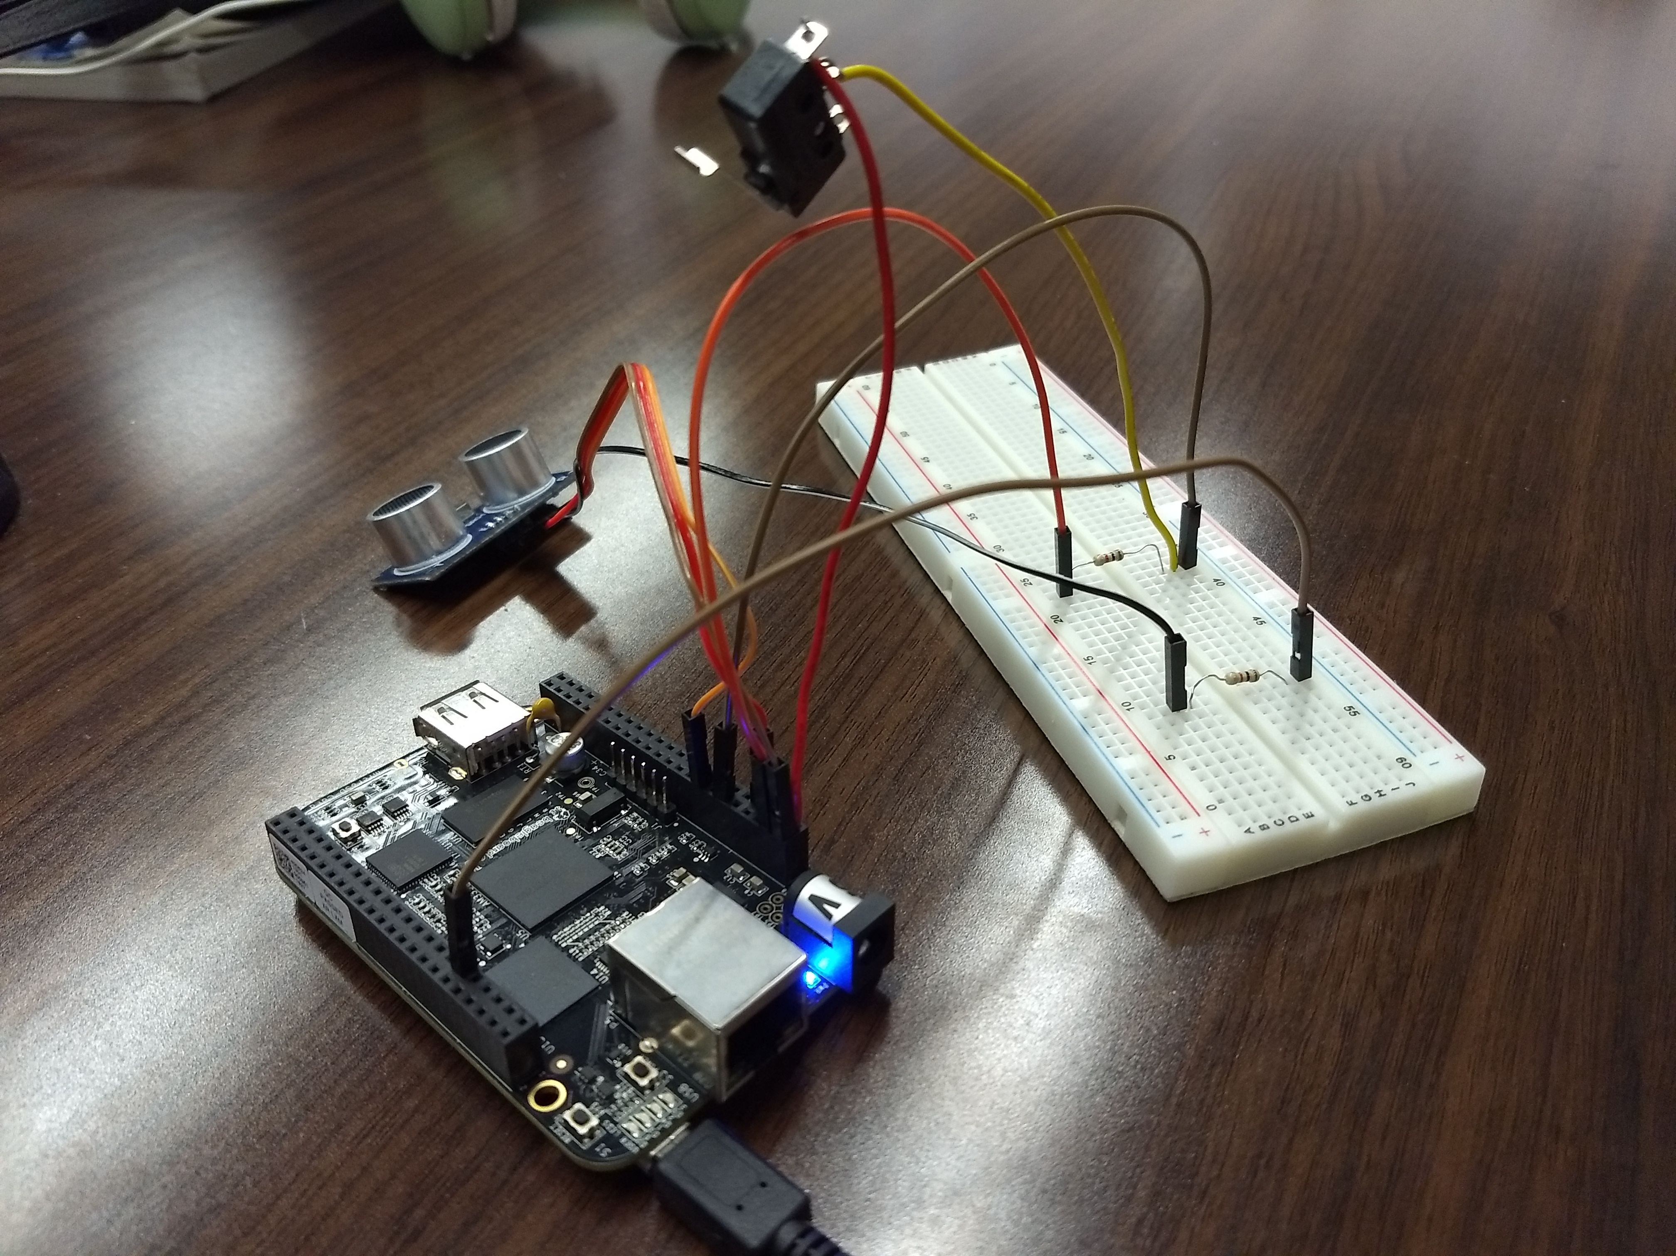
Beaglebone connection without XBEE

Slide 38
LINK TO THE SOURCE CODE ON GITHUB:
https://github.com/SachinPawaskarUNO/codecrush-iot/blob/master/activities/ultrasonic/ultrasonic2.c

Slide 39
Notes:
DO NOT DELETE THIS SLIDE. Please keep at the end of your presentation.

